Slide 1

4. Promote first Domain Controller
Windows Server 2019 Basics

Slide 2
What to check first
Server name
IP settings
Notes:
Before promoting your first domain controller make sure that the server name is set correctly. It is also a good idea to check the IP settings so that you do not have to change the IP address after that and update it in DNS

Slide 3
Steps
Install the Active Directory Domain Services role
Promote the server to a domain controller
Restart the server after promotion is finished
Notes:
The general steps to install a domain controller are:
- Install the ADDS role
- Promote the server to a domain controller
- Make sure you restart the server after that if it does not do it automatically

Slide 4
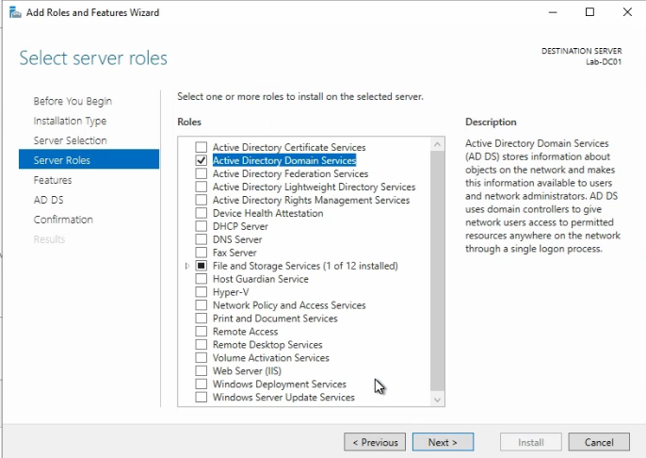
Install the ADDS role
Notes:
To install the AADS role:
- From server manager click on Manage
- Click on Add roles and features
- Press Next until you get to the roles screen and select Active Directory Domain Services

Slide 5
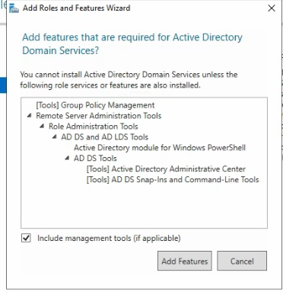
Install the Graphical tools also
Notes:
You will be prompted to install also some extra tools. Just click on Add Features then continue.

Slide 6
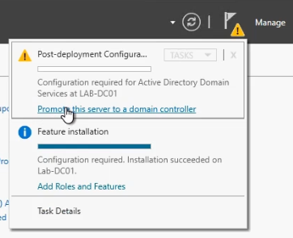
Promote the server
Notes:
After the ADDS role is installed you will see an exclamation mark in the server manager. Click on it and then click on Promote this server to a domain controller.

Slide 7
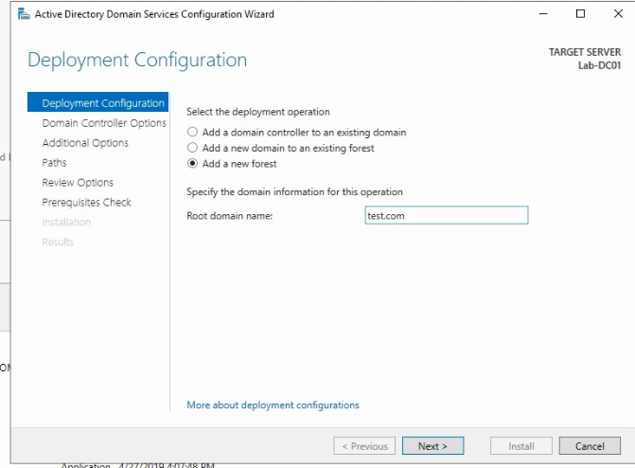
Promote the server
Notes:
You will first be prompted to select what installation type you want to make. In this case, since no domain exists and also no forest exists, we will create a new forest.
A root domain name also has to be specified. This can be anything that is a valid domain name.

Slide 8
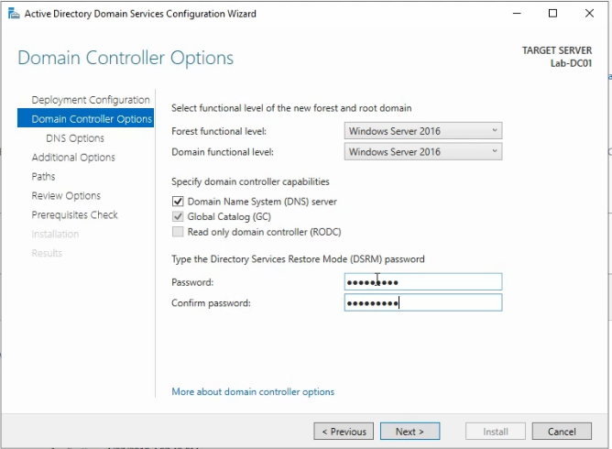
Promote the server
Notes:
Next there are a couple of things to set up. Firstly the Domain and Forest functional levels. You can leave them at the default value in this case. The levels determine what functionalities you will have in your Active Directory so the high value is always preferred if possible (the domain level can be as high as the lowest domain controller OS version in your domain and the forest level can be as high as the lowest domain level in your forest)
Any domain has to have at least a Global Catalog so this cannot be unchecked.
Since AD uses DNS to function it is best to install also the DNS role and let the wizard configure it.
Be careful when setting the AD Restore Mode password. You should be able to find it if it is ever needed. With this password you can log on to the domain controller with the AD database detached and perform recovery jobs on the Active Directory database.

Slide 9
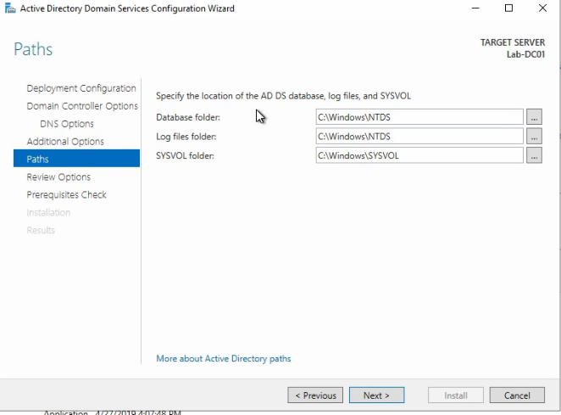
Promote the server
Notes:
Active directory is actually a database and this database is stored on the file system. So you can leave the path to it as the default or select a different one. The same for the logs folder and the SYSVOL folder.

Slide 10
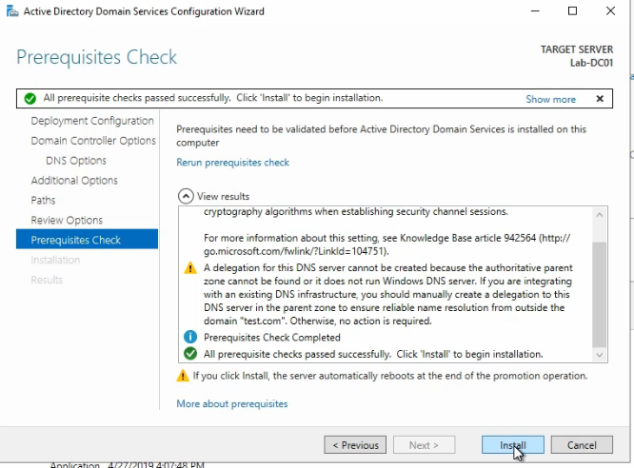
Promote the server
Notes:
After everything is configured and the prerequisites check is passed you can go ahead and promote the server to a domain controller.

Slide 11
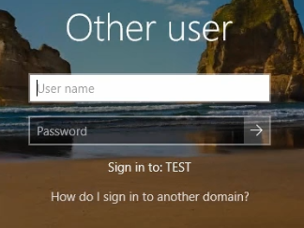
Log on using domain credentials
Notes:
After the server has restarted you can log on. Notice that the log on location is actually the domain TEST. This means that the user you will use is not stored on the server locally but in the AD database.

Slide 12
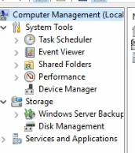
No local users and groups anymore
Notes:
A domain controller does not have any local users and groups. Any right that you want to give on this server is done from Active Directory. This is, of course, a security measure.

Slide 13
https://www.youtube.com/channel/UCcZ-jLbPwNr8E_v9-65n8Iw https://github.com/itknowledge4

